Slide 1



Credit Where Credit’s Due: Predicting Loan Defaulting
DA 6813 Project
Rani Misra
Notes:
Hello. My project is based on predicting the defaulting of loans.

Slide 2

Financial Loans
53.4 million loan accounts in Q2 of 2024
Delinquency rates increase for auto and mortgage loans
Firms can use machine learning models to prevent high-risk customers from borrowing.
Background
Notes:
Financial loans are widely used in the U.S. to finance homes, vehicles, businesses, and cover existing debts. According to TransUnion’s Q2 2024 Insights Report, mortgage loans continue to rise, reaching 53.4 million accounts. With such a large market, the risk of borrowers defaulting also grows. The report shows year-over-year increases in delinquency rates for both auto and mortgage loans. In response, financial institutions aim to minimize defaults and improve repayment rates. One key strategy is using machine learning to identify high-risk borrowers and better target their financial services.

Slide 3
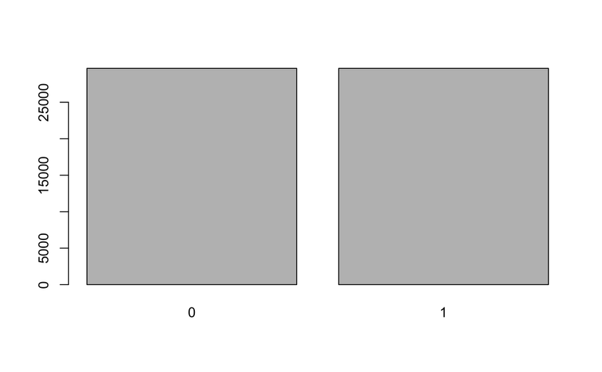
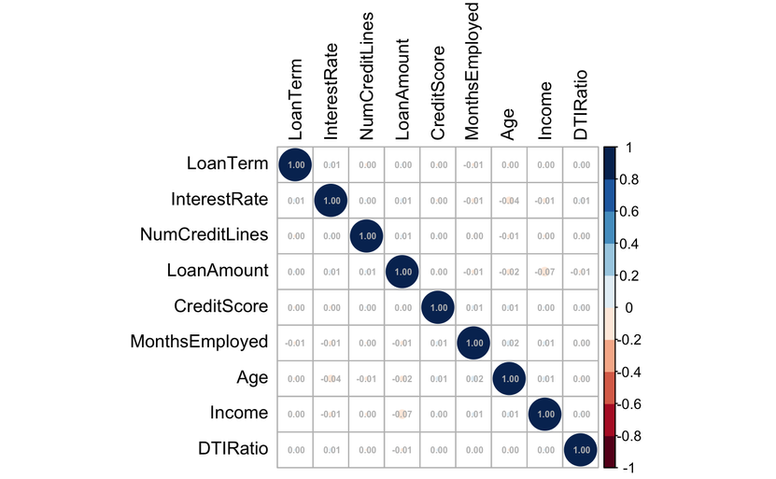

Data Overview
Contains 255,347 observations and 18 variables such as age, income, loan amount, credit score, education, employment, marital status, etc.
Data downsampled to balance classes (total observations = 29,653).
No variables with high correlation.
Notes:
The dataset includes 255,347 observations and 18 variables, sourced from Coursera’s Loan Default Prediction Challenge and accessed via Kaggle. It contains demographic and behavioral factors that may influence loan default, such as age, income, credit score, loan amount, education, employment, marital status, dependents, and loan purpose. The target variable is imbalanced, so the data was downsampled to ensure equal representation of default and non-default cases for more reliable analysis. There are no missing values, and a correlation check of numeric variables revealed no issues of concern.

Slide 4


Motivation Questions
1. Are borrowers with dependents more likely to default? Are there any other factors that skew the effect of having dependents?
2. Does a higher Debt-to-Income ratio increase the risk of a borrower defaulting?
3. Are there any variations in default rates across types?
4. Does having a co-signer reduce default risk?
5. Are credit scores an accurate measure of a borrower’s capability of not defaulting?
Notes:
To guide this project, I focused on five key motivation questions:
First, Are borrowers with dependents more likely to default? Are there any other factors that potentially skew the effect of having dependents?
Borrowers with dependents may face higher personal expenses, reducing income available for loan payments and increasing default risk. However, if married, a spouse’s income could help balance household finances and improve loan repayment ability.
Does a higher Debt-to-Income ratio increase the risk of a borrower defaulting?
A higher Debt-to-Income ratio indicates that the borrower might be dedicating a large portion of their income to pay off existing debt. Those with multiple credit lines might find it difficult to balance repaying all their debt back in a timely manner. Multiple obligations can also result in financial inflexibility when handling emergency costs, possibly resulting in delayed or defaulted loan payments.
Are there any variations in default rates across types?
Loan purpose can affect default risk. Home loans may be safer due to collateral, while business loans carry higher risk from market uncertainty.
Does having a co-signer reduce default risk?
A co-signer offers lenders backup if the borrower defaults, encouraging timely payments to protect the co-signer’s credit. However, if the co-signer lacks financial responsibility, the borrower may be less motivated to pay on time.
Are Credit Scores an accurate measure of a borrower’s capability of not defaulting?
Credit scores reflect past payment behavior but don’t account for current stability or future income. A high score borrower may still default due to sudden setbacks, while a lower score borrower with steady income might reliably repay loans.
In the following slides, I’ll test these claims using hypothesis testing and statistical modeling.

Slide 5
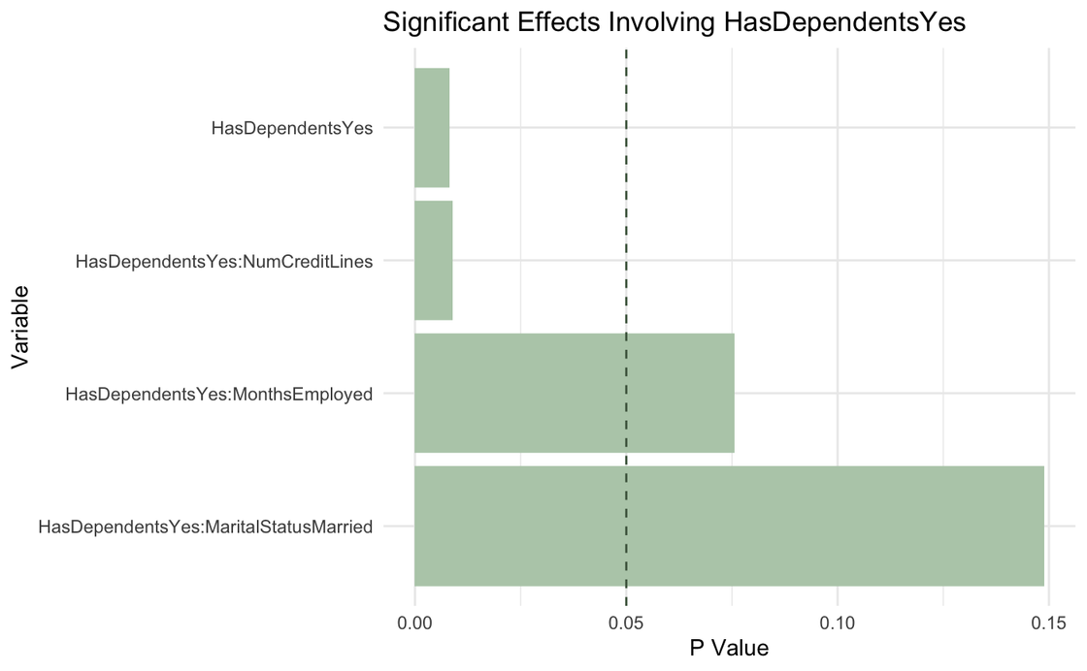
Are borrowers with dependents more likely to default? Are there any other factors that potentially skew the effect of having dependents?
Chi-square test shows a significant association between dependents and default.
Logistic model includes HasDependentsYes and its interactions.
HasDependentsYes and its interaction with NumCreditLines are significant predictors.
Dependents reduce default risk overall.
Default risk slightly increases with more credit lines for those with dependents.
Notes:
To test if borrowers with dependents are more likely to default, I ran a chi-square test, which showed a significant association between having dependents and defaulting. I then built a logistic regression model including the variable HasDependentsYes and its interactions. The main effect of HasDependentsYes was significant, indicating that borrowers with dependents are generally less likely to default than those without, even after controlling for factors like income, employment type, education, marital status, and loan characteristics. However, the interaction between HasDependentsYes and NumCreditLines was also significant. This suggests that while dependents may be linked to lower default risk overall, that benefit weakens as the number of credit lines increases—possibly due to the added financial strain of managing multiple accounts alongside dependent-related expenses.

Slide 6

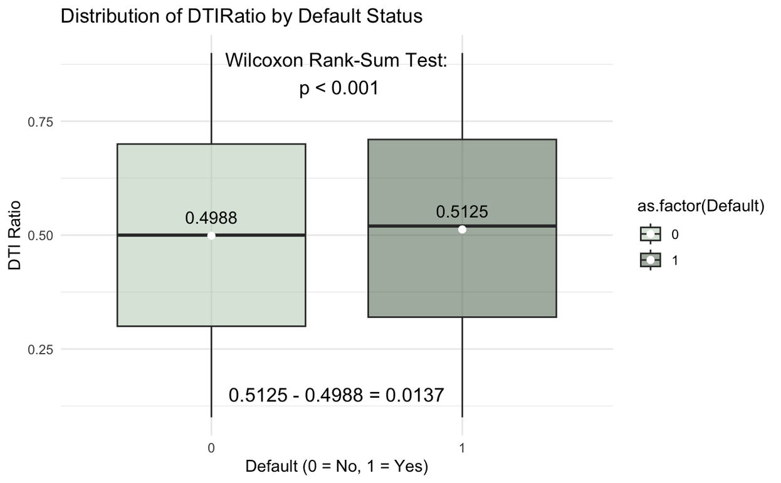
Does a higher Debt-to-Income ratio increase the risk of a borrower defaulting?
Wilcoxon Rank-Sum test shows a significant difference in median DTI ratios by default status.
Logistic model with DTIRatio alone is significant.
Higher DTIRatio increases the log-odds of default.
Notes:
To test whether a higher Debt-to-Income (DTI) ratio increases default risk, I used a Wilcoxon Rank-Sum test since the distribution of DTIRatio is not normal. The test was significant, showing strong evidence that the median DTI ratios differ between defaulters and non-defaulters. While the observed difference is about 1.37%, the large sample size of around 29,000 observations makes this difference meaningful.
I also ran a logistic regression with DTIRatio as the sole predictor for default. The model was statistically significant, and the positive coefficient indicates that as DTI increases, so do the odds of defaulting—further supporting the test result.

Slide 7
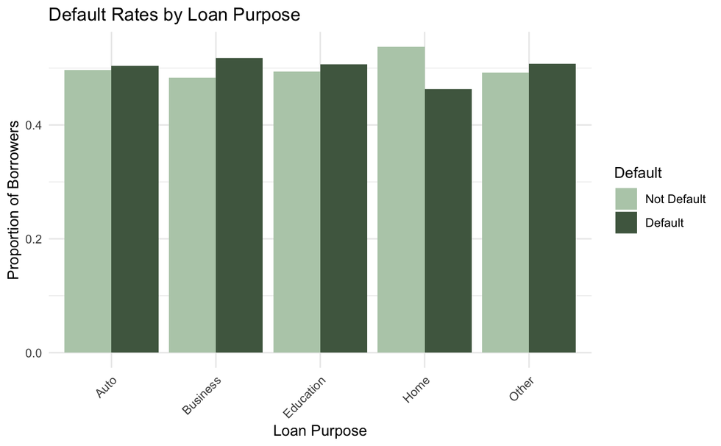
Are there any variations in default rates across types?
Chi-square test shows default rates vary by loan purpose.
Logistic model with LoanPurpose is significant.
Business loans have ~6% higher odds of default than auto loans.
Home loans have ~15% lower odds of default than auto loans.
LOAN PURPOSE | COEFFICIENT | ODDS RATIO | PERCENT CHANGE
Intercept (Auto) | 0.01383471 | 1.0139308 | 1.393085
Business | 0.05523724 | 1.0567913 | 5.679130
Education | 0.01183138 | 1.0119017 | 1.190165
Home | -0.16178818 | 0.8506214 | -14.937863
Other | 0.01644245 | 1.0165784 | 1.657837
Notes:
To examine whether default rates vary by loan purpose, I ran a chi-square test, which confirmed a significant association—some loan types are more prone to default than others.
Logistic regression results show that business loans are significantly more likely to default compared to the baseline of auto loans, with about a 6% higher odds. In contrast, home loans are less risky, showing nearly a 15% lower odds of default. These results support the idea that collateralized loans like home loans may be safer, while business loans are riskier due to market uncertainty.
The plot shows the proportion of borrowers that default based on the total amount of borrowers in that loan type. The largest differences can be seen within business, where defaulters are higher than non-defaulters, and home, where non-defaulters are much higher than defaulters.

Slide 8
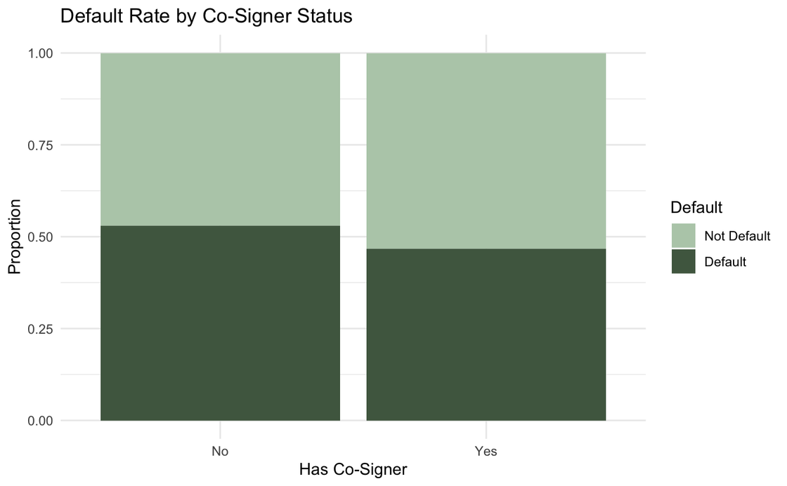

Does having a co-signer reduce default risk?
Chi-square test shows a significant link between co-signers and default.
Logistic model with HasCoSignerYes is significant.
Having a co-signer reduces default odds by ~21.95%.
Notes:
To examine whether having a co-signer influences the likelihood of default, I conducted a chi-square test, which showed a significant association between having a co-signer and default risk.
The logistic regression results indicate that having a co-signer significantly reduces the odds of default by about 21.95% compared to borrowers without a co-signer.
The plot illustrates the default rates for borrowers with and without a co-signer. Among borrowers without a co-signer, more than half (53%) defaulted, while the default rate for those with a co-signer dropped to 46.8%. This visual shift shows the protective effect of a co-signer, with a higher proportion of non-defaulters when a co-signer is present.

Slide 9
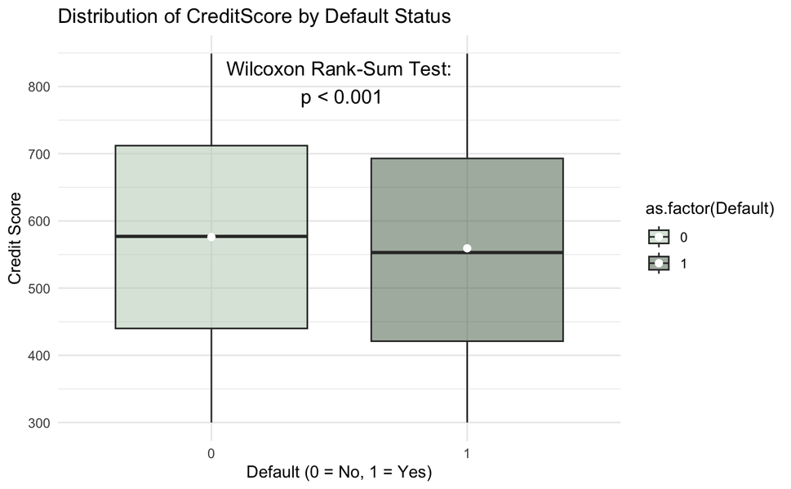
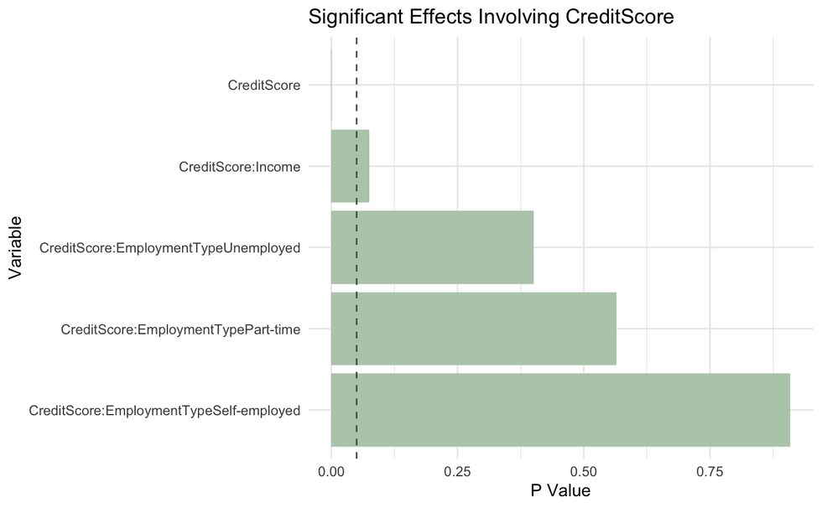
Are credit scores an accurate measure of a borrower’s capability of not defaulting?
Wilcoxon Rank-Sum test shows a significant difference in CreditScore by default status.
Logistic model includes CreditScore, Income, EmploymentType, and interactions.
Each 1-point increase in CreditScore lowers default odds by ~0.066%.
Interactions are not significant—no evidence that income or employment type alters the effect of credit score on default.
Notes:
To explore whether credit scores accurately predict default risk, I ran a non-parametric Wilcoxon Rank-Sum test, which showed a statistically significant difference in credit scores between defaulters and non-defaulters.
The logistic regression results confirm that credit score is a significant predictor, with each 1-point increase in credit score lowering the odds of default by about 0.066%.
However, when examining interactions between credit score and other factors like income or employment type, no significant results were found. This suggests that while credit score alone plays a role in default risk, a borrower’s financial stability or employment status may not significantly alter this relationship in the model.

Slide 10
Model Comparisons
Notes:
I tested three different models to predict defaulting for this dataset.

Slide 11
Types Tested
Logistic
KNN
Random Forest
Categorical target variable
Provides odds ratios for each variable, making interpretations and influence of each feature easier to explain
Might be beneficial if non-linear relationships are present within the data
More flexible and might be able to capture more complex relationships that logistic regression couldn’t
Able to handle highly dimensional data
Model can select among many variables to find the best features for the tree
Able to reduce overfitting by combining multiple decision trees
Notes:
The three types I tested were logistic regression, KNN, and random forest.
Logistic regression is ideal for this binary target variable, as it provides easy interpretation of odds ratios and helps identify key factors influencing default risk.
KNN is useful for capturing non-linear relationships, offering more flexibility than logistic regression. It may uncover complex patterns in default behavior.
Random Forest is effective for high-dimensional data and reduces overfitting by combining multiple decision trees. It can also identify the most important predictors for loan default.

Slide 12
Pre-Processing Steps
Data is split into 70/30 training and testing sets.
Numeric variables such as Age and Income are standardized, centered, and scaled to remove scale differences.
Default is given class labels of “No” for 0 and “Yes” for 1.
All models undergo 5 fold cross validation and use ROC as tuning metric since it is more robust.
Notes:
To pre-process the data for modeling, I split the dataset into 70% training and 30% testing subsets. Numeric variables were standardized, centered, and scaled to remove scale differences. Default was given labels of No for values of 0 and Yes for values of 1. All models went through 5 fold cross validation and used ROC as the tuning metric since it was more robust.

Slide 13


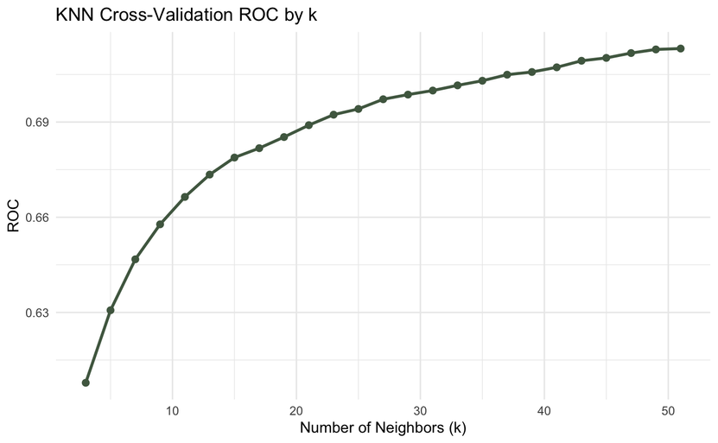
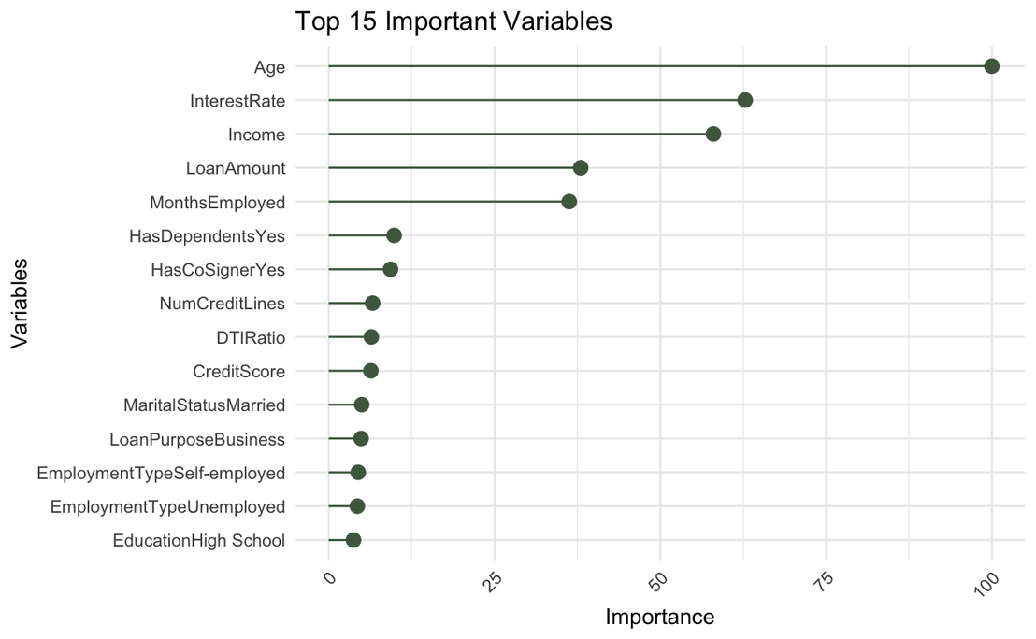
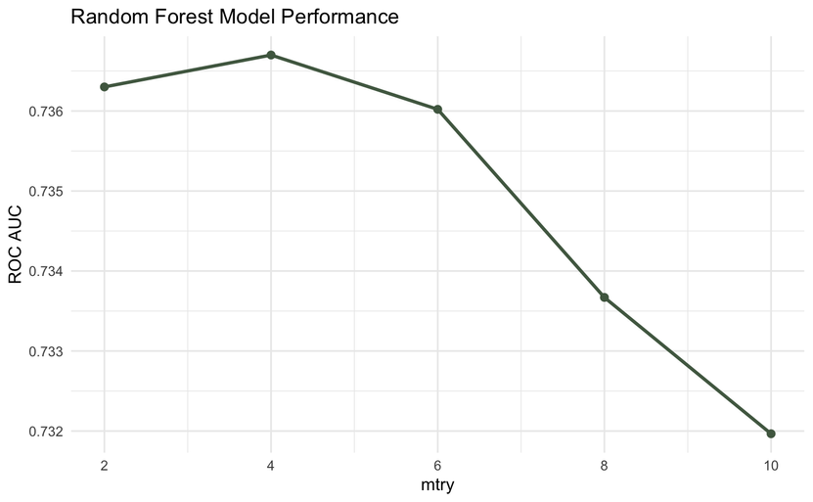
Results
Notes:
The full logistic regression model was fit, cross-validated, and used for prediction.
For the KNN model, a tuning grid of odd K values from 3 to 51 was tested. The best was K = 51 based on the ROC curve. As the accuracy did not decline as K increased, it is possible that a better K is available. However, it is too computationally intensive to currently test.
The Random Forest model was hyper-tuned based on the number of variables sampled at each split. The best mtry = 4, with the most important variables being Age, InterestRate, Income, LoanAmount, and MonthsEmployed. A reduced Random Forest model was then created using only these key variables as an additional model to test.

Slide 14
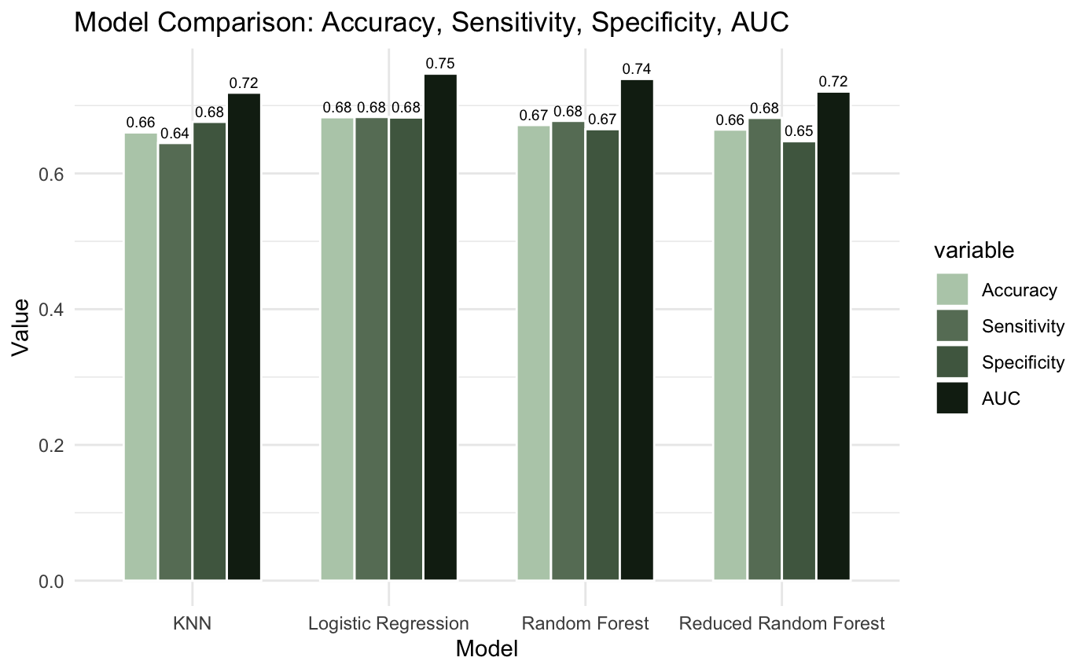
Model Metrics Comparison
Logistic model is consistently the best across all metric categories.

Slide 15
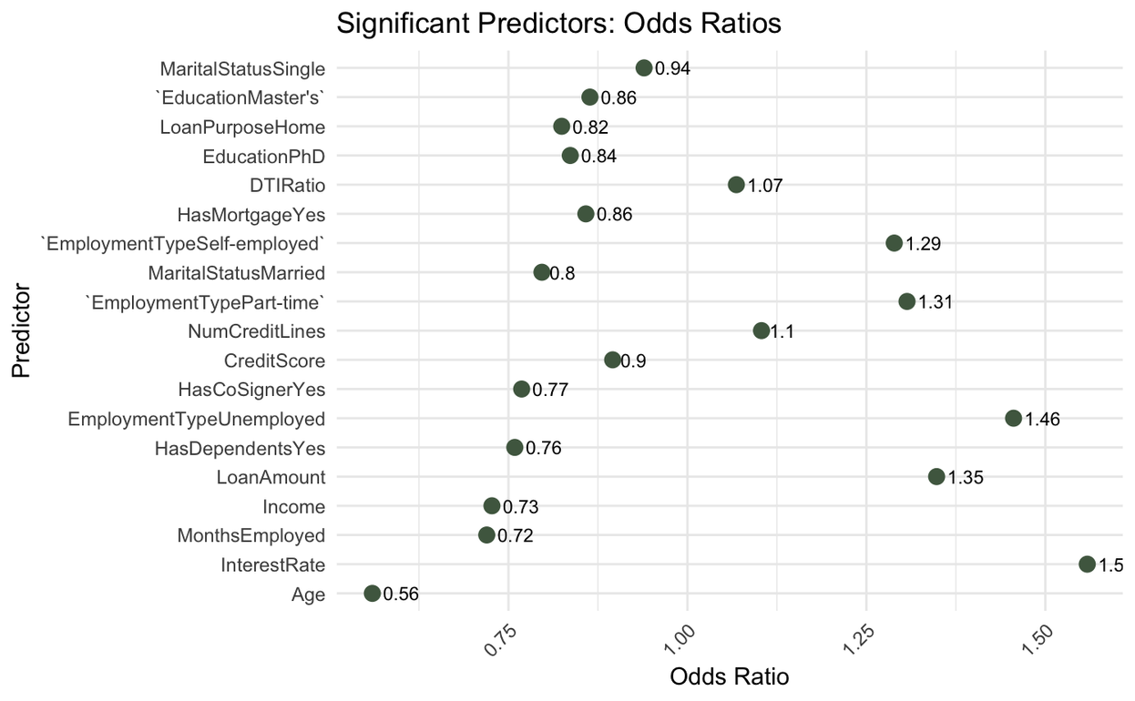
Logistic Model: Odds Ratio Interpretations
Factors That Decrease Odds of Defaulting:
Age, Income, CreditScore, MonthsEmployed, having a Master’s or PhD, being Married or Single, HasMortgageYes, HasDependentsYes, LoanPurposeHome, HasCoSignerYes.
Factors That Increase Odds of Defaulting:
LoanAmount, NumCreditLines, InterestRate, DTIRatio, being employed Part-time, Self-employed, or Unemployed.
Notes:
This slide presents factors that influence loan default risk. Factors that decrease the odds of default, such as Age, Income, and CreditScore, are shown with odds ratios less than 1, indicating lower default risk. On the other hand, factors that increase the odds of default, like LoanAmount and InterestRate, have odds ratios greater than 1. The plot is arranged from the most statistically significant to the least statistically significant, with factors such as having a co-signer or being married providing protective effects, while higher loans or part-time employment increase default risk.

Slide 16
Conclusions
Insights
Dependents reduce default risk; risk rises with many open credit lines.
Higher DTI ratio → higher default risk.
Loan purpose matters: business loans are riskier, home loans safer.
Higher credit scores → lower risk.
Logistic regression was the most accurate and interpretable model.
High-risk: young, low-income, unemployed/self-employed, high DTI, business loans.
Low-risk: older, high-income, mortgages, dependents, co-signers, home loans.
Risk-based lending tailors terms to borrower profiles.
Promote co-signers to reduce risk.
Market safe products with incentives to low-risk borrowers.
Use multivariable models like logistic regression for better risk assessment.
Notes:
This analysis reveals several insights for improving loan default prediction and risk management.
Borrowers with dependents tend to default less, though multiple credit lines can increase risk.
A higher debt-to-income ratio (DTI) strongly predicts higher default risk.
Not all loans carry the same level of risk. Business loans are significantly riskier, while home loans, often secured and for essential needs, tend to be safer.
Having a co-signer reduces risk, showing the importance of shared accountability.
Higher credit scores correlate with lower default risk, but they should be considered alongside other factors.
Logistic regression proved to be the best model for prediction, offering both accuracy and interpretability.
Using these insights, lenders can personalize risk pricing, encourage co-signers, promote safer loan products with incentivized terms, such as lower interest rates or faster approvals, and move beyond just credit scores to create a more comprehensive risk assessment model.

Slide 17
Thank you!

